Slide 1
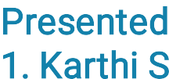


KEYLOGGERS SECURITY & IMPLEMENTATION
Presented By:
1. Karthi S– Fatima Michael College Of Engineering And Technology Madurai –Computer Science And Engineering

Slide 2



OUTLINE
Problem Statement (Should not include solution)
Proposed System/Solution
System Development Approach (Technology Used)
Algorithm & Deployment
Result (Output Image)
Conclusion
Future Scope
References

Slide 3
PROBLEM STATEMENT
Example: In today's digital age, where cybersecurity threats loom large, one of the signiﬁcant concerns is the proliferation of keyloggers, stealthy software tools designed to monitor and record keystrokes on a user's computer without their knowledge. Keyloggers pose a severe threat to individuals and organizations as they can capture sensitive information such as passwords, credit card details, and other personal data, leading to identity theft, ﬁnancial loss, and privacy breaches.

Slide 4

PROPOSED SOLUTION
Purpose and Justiﬁcation: Clearly deﬁne the purpose of deploying the keylogger and ensure that it's justiﬁed and legal. Whether it's for parental control, employee monitoring, or forensic investigation, ensure there's a legitimate reason for its use.
Informed Consent: Obtain informed consent from users before deploying the keylogger. Users should be aware that
their activities are being monitored, and consent should be obtained in accordance with relevant privacy regulations.
Secure Development: Develop the keylogger with security in mind. Follow secure coding practices, such as input
validation, to prevent vulnerabilities like buffer overﬂows or injection attacks. Use reputable programming languages
and libraries to minimize security risks.
Data Encryption: Encrypt logged data to protect it from unauthorized access. Implement strong encryption algorithms and key management practices to ensure that even if the data is intercepted, it remains secure.
Access Control: Implement robust access control mechanisms to restrict access to the logged data. Only authorized individuals should be able to view or retrieve the logged information, and authentication should be required to access the keylogger's conﬁguration settings

Slide 5

SYSTEM APPROACH
Purpose and Justiﬁcation: Clearly deﬁne the purpose of deploying the keylogger and ensure that it's justiﬁed and legal. Whether it's for parental control, employee monitoring, or forensic investigation, ensure there's a legitimate reason for its use.
Informed Consent: Obtain informed consent from users before deploying the keylogger. Users should be aware that their activities are being monitored, and consent should be obtained in accordance with relevant privacy regulations.
Secure Development: Develop the keylogger with security in mind. Follow secure coding practices, such as input validation, to prevent vulnerabilities like buffer overﬂows or injection attacks. Use reputable programming languages and libraries to minimize security risks.
Data Encryption: Encrypt logged data to protect it from unauthorized access. Implement strong encryption algorithms and key management practices to ensure that even if the data is intercepted, it remains secure.
Access Control: Implement robust access control mechanisms to restrict access to the logged data. Only authorized individuals should be able to view or retrieve the logged information, and authentication should be required to access the keylogger's conﬁguration settings

Slide 6

ALGORITHM & DEPLOYMENT
Algorithm Design:
Keylogging Mechanism: Deﬁne how the keylogger will capture keystrokes. This may involve hooking into the operating system's keyboard events or using low-level keyboard input functions.
Data Encryption: Determine the encryption algorithm and key management scheme to encrypt the logged keystrokes. Popular choices include AES (Advanced Encryption Standard) for symmetric encryption and RSA (Rivest-Shamir-Adleman) for asymmetric encryption.
Deployment Process:
Installation: Install the keylogger software on the target device(s) using appropriate deployment methods. This may involve manual installation by physical access to the device, remote deployment through software distribution tools, or social engineering techniques.
Conﬁguration: Conﬁgure the keylogger settings according to the desired monitoring requirements, such as specifying the logging interval, encryption keys, and destination for logged data.
Testing: Conduct thorough testing of the deployed keylogger to ensure that it captures keystrokes accurately, encrypts data securely, and operates as expected without causing performance issues or detection by antivirus software.

Slide 7
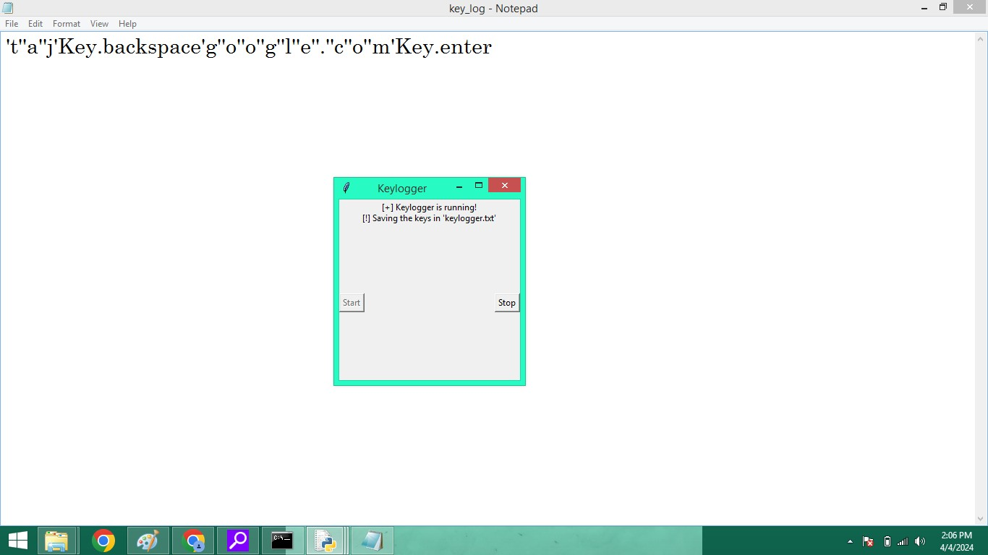
RESULT
The result of deploying a keylogger system would be the effective monitoring and logging of keystrokes on the target device(s), as per the speciﬁed algorithm and deployment strategy. Here are the key outcomes:

Slide 8
CONCLUSION
Implementing keylogger prevention and security measures is crucial for organizations to safeguard their systems, data, and reputation from malicious attacks. By following a systematic approach that includes thorough risk assessment, deployment of appropriate security solutions, user education, continuous monitoring, and eﬃcient incident response procedures, organizations can signiﬁcantly enhance their security .

Slide 9
FUTURE SCOPE
The future scope of keyloggers, as with many other technologies, will likely involve advancements in both legitimate and malicious applications. Here are a few potential future trends:Increased Sophistication: Malicious actors may develop more sophisticated keyloggers capable of evading detection by traditional antivirus and security software. This could involve the use of encryption, polymorphism, or other obfuscation techniques.Targeted Attacks: Keyloggers may be increasingly used in targeted attacks against speciﬁc individuals or organizations. Attackers may employ social engineering tactics to trick users into installing keyloggers or use them as part of advanced persistent threats (APTs).

Slide 10
REFERENCES
Practical Malware Analysis: The Hands-On Guide to Dissecting Malicious Software" by Michael Sikorski and Andrew Honig."The Art of Memory Forensics: Detecting Malware and Threats in Windows, Linux, and Mac Memory" by Michael Hale Ligh, Andrew Case, Jamie Levy, and Aaron Walters."Malware Analyst's Cookbook: Tools and Techniques for Fighting Malicious Code" by Michael Hale Ligh, Steven Adair, Blake Hartstein, and Matthew Richard."Practical Reverse Engineering: x86, x64, ARM, Windows Kernel, Reversing Tools, and Obfuscation" by Bruce Dang, Alexandre Gazet, and Elias Bachaalany."Hacking: The Art of Exploitation" by Jon Erickson.

Slide 11
THANK YOU

